Slide 1
GA Data Science Project
Understanding “Lending Club” loan data performance.

Slide 2
Lending Club Background
Lending Club is a "Market Place Lender" which allows an individual to apply for a personal loan to be filled by the market, as opposed to a bank or other lender. They have grown in success and to date have closed over $3Bn in loans.
Lending Club has made loan and performance information freely available on their website. The data is available on the Lending Club website. I manually downloaded the CSV files and stored them locally. I am using only one subset of the total lending club data.

Slide 3
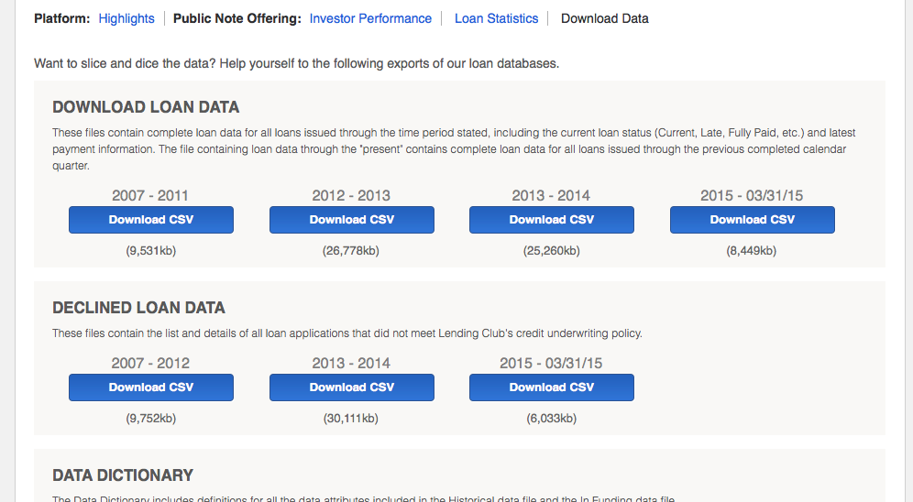
Lending Club (Continued)

Slide 4
Objectives
My objectives in this project are threefold:
i) Learn how to view, clean and manipulate datasets in Python;
ii) Develop better intuition for fitting estimators to the data;
iii) Start to develop a better way to predict creditworthiness of borrowers beyond the current credit metrics (eg, FICO). For example, can we parse their loan purpose comments to develop a predictor of default?

Slide 5
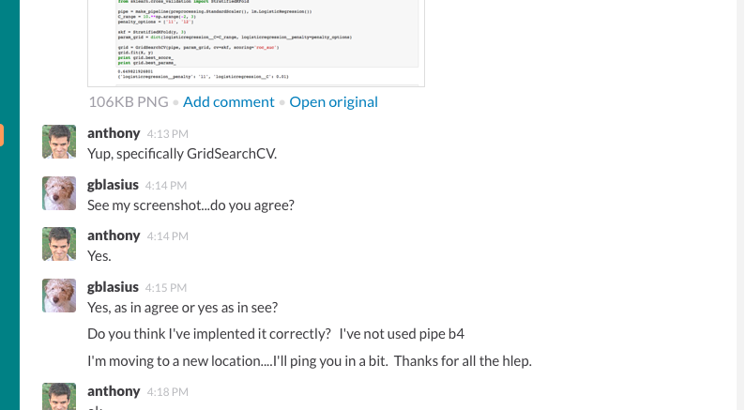
Anthony (& Josh) were a great help!! (one page out of hundreds).

Slide 6
Steps in my journey
1) Read in data, and clean;
2) Visualize data to gain an intuition;
3) Create calculated features;
4) Try to fit estimators to data and evaluate
1) As predicted took up much of my time. There are still lots of things I’d like to do with the data. I only started work on the estimators this week. Lots more to do!

Slide 7
Read in data and clean.
The .csv file had some imperfections (such as unexpected blank lines in the middle of the dataset), which consumed a lot of time.
All NaNs are not created equal; some needed to be eliminated, others had meaning. For example, “Months since last delinquency” feature was left empty if borrower was not ever delinquent.

Slide 8
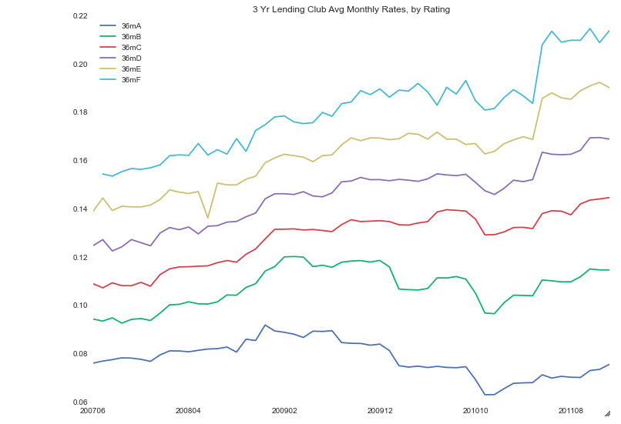
Visualize Data (Lending Club Loan Rates by Borrower Rating)

Slide 9
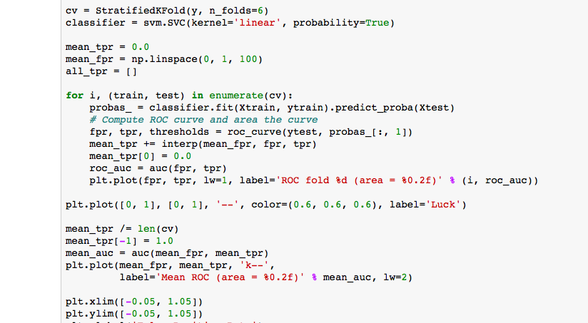
Learn how to fit and tune estimators!

Slide 10
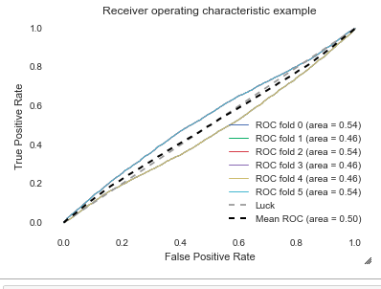
But lots more needs to be done…(oops).

Slide 11
Conclusions
I underestimated the amount of work needed to clean data, even though it was readily sourced.
Some of this included thinking about how to structure/use data….I’m still learning more about this.
Lots more work needs to be done on estimators!!

